Slide 1
JavASCRIPT

Slide 2
Widely used..
Surprisingly Powerful ,sometimes odd, often beautiful..
We would focus on JS, not on making pages beautiful..
May be you are from JS or other backgrounds…
This will help you in dealing with weirds parts and understand JS features.. When you truly understand… its deceptively powerful and you would know its powerful..
Don’t imitate , understand..
Examples are important.. But you wont be able to debug.. And anything not covered in example … you wont be able to come up with innovative solutions.. And also understand modify others code..

Slide 3
Lets make concepts , vocabularies, complicated words simple..

Slide 4
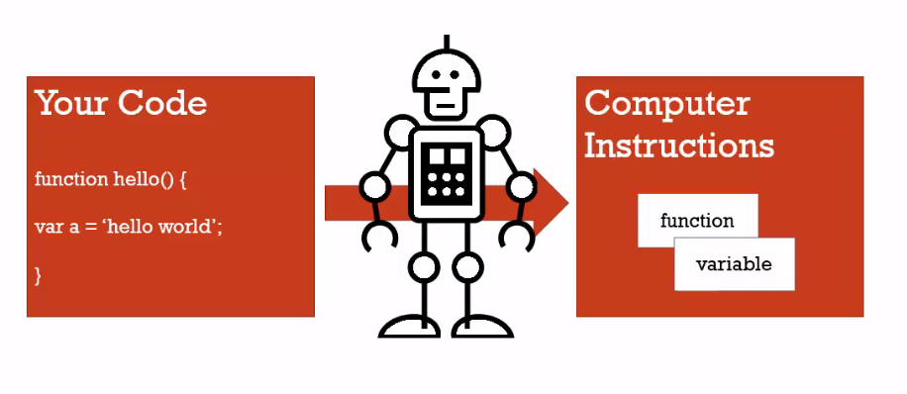
Syntax parser – A program that reads your code and decides what to do with it.
(Compilers, interpreters)

Slide 5
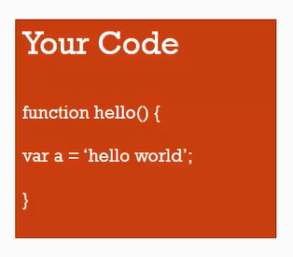
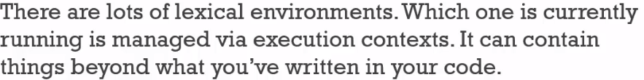
Lexical Environments
Lexical means having to do with words and grammar.
LE exists in programming language is where you write something is important .
-- where its written and what surrounds it is important.
Execution Context
A wrapper to manage the code that is running.

Slide 6
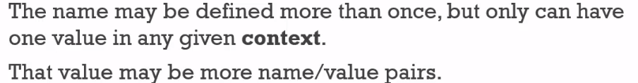
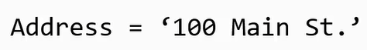
Name value Pair

Slide 7
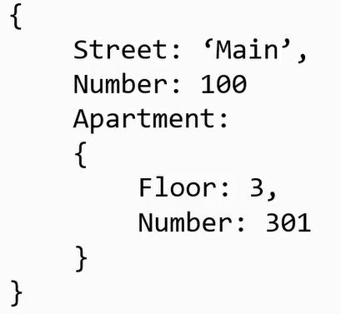
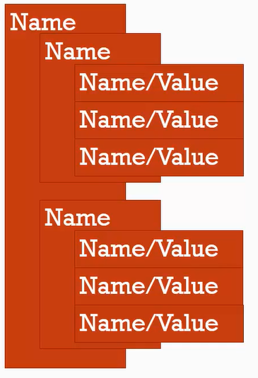
Objects
Collection of name value pairs..
Nested ? ------------ Yes

Slide 8
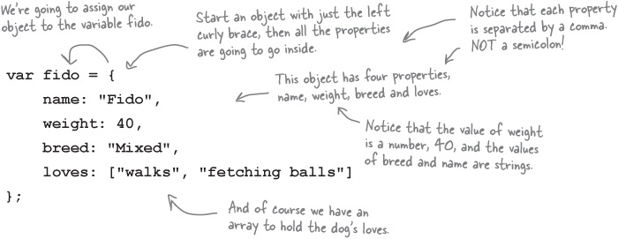

Slide 9
Execution Context (Global) – Base Execution context
Global object – this , window
When we say global– not inside a function
When you create a variable and function , they are global. (when not lexically inside a function )

Slide 10
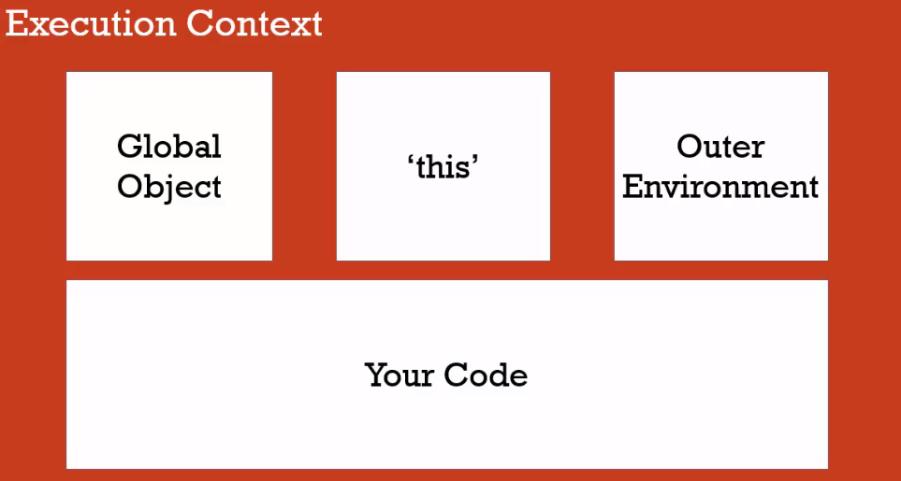
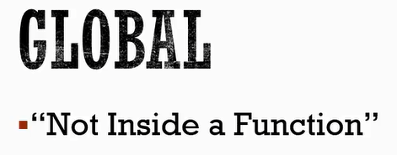

Slide 11
The Execution Context (Creation and Hoisting)
Execution context two phases.
Phase 1 : Creation (Recognizes functions and variables, assigns memory space for them(hoisting)), entire function code but only variable declaration
Phase 2 : Execution (Assignments)
All variables are set to undefined. Bad idea to rely on hoisting.

Slide 12
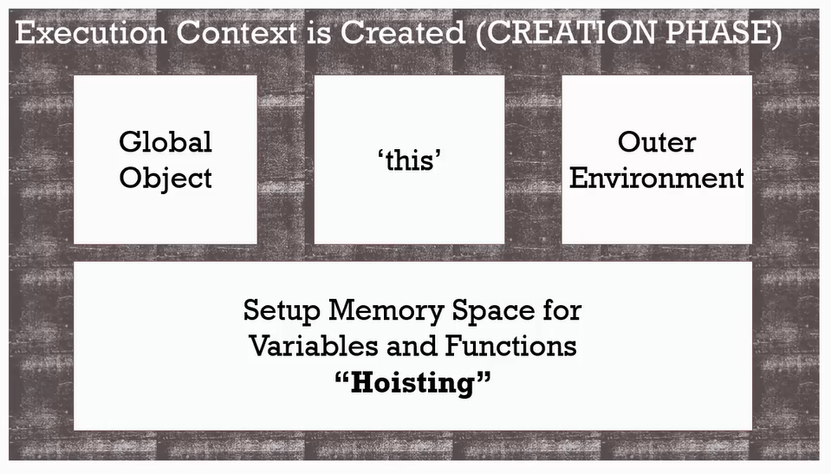

Slide 13
‘undefined’ and Javascript
‘undefined’ means variable has not been set. Its special keyword or value. It doesn't mean NOT DEFINED.
Never set variable to undefined. Actually you can but never do it. Programmers should not set it. It would be harder to debug either you set it or Javascript engine did.
Undefined-- I would have said it notSet instead of undefined .But that is how it is.

Slide 14
Execution Context
Phase 2 : Execution (Assignments) – code execution

Slide 15
Single Threaded – One command at a time
Under hood browser may not be
Synchronous : One at a time and in order
AJAX – asynchronous (How--- not now ☺ )

Slide 16
Function invocation and execution stack
Invocation : calling the function ( )

Slide 17
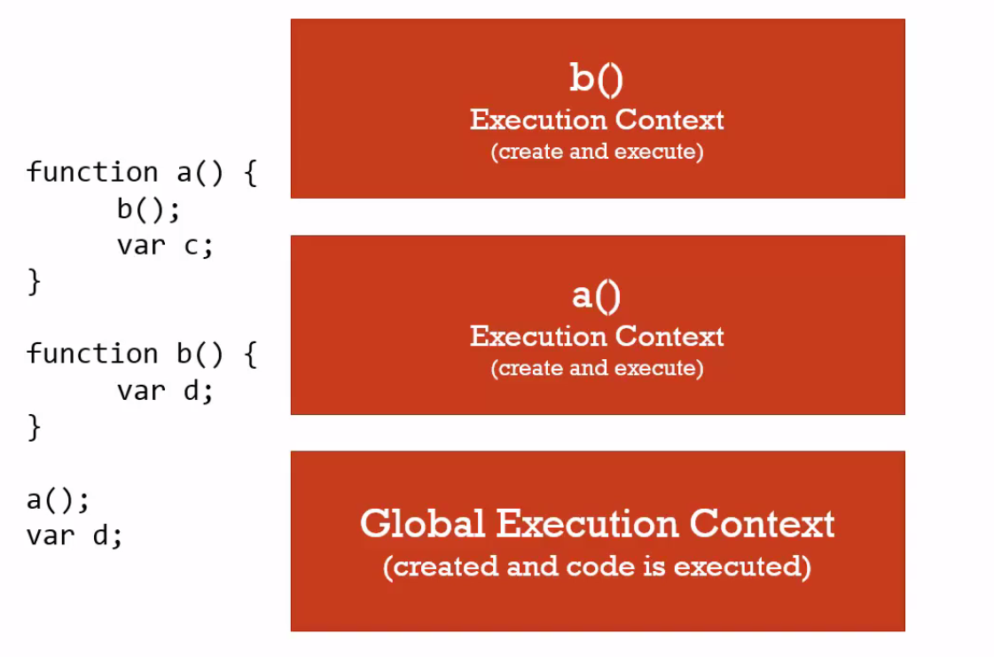

Slide 18
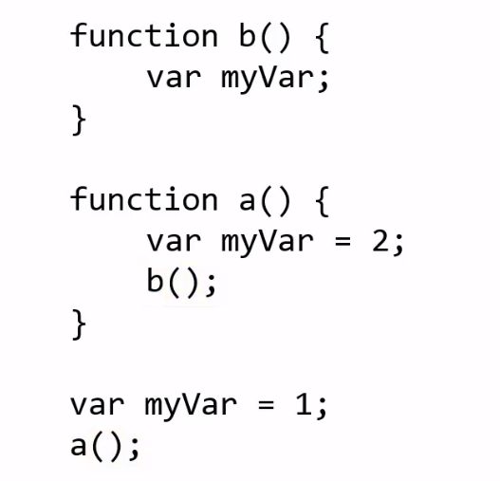
Functions, Context, and Variable Environments
Variable Environments
Where is variable lying

Slide 19
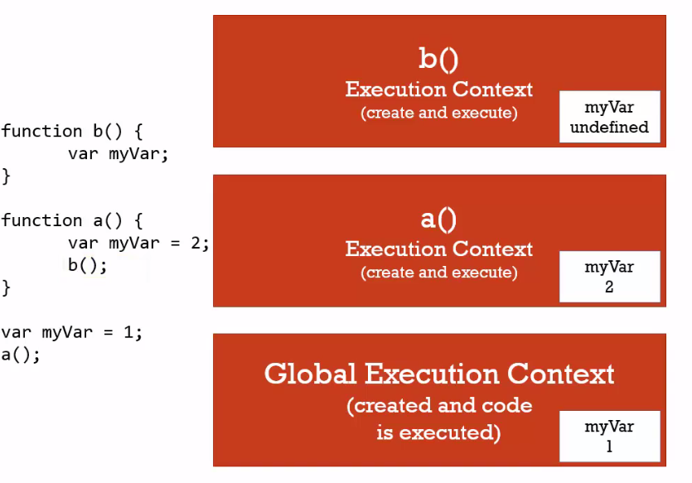

Slide 20
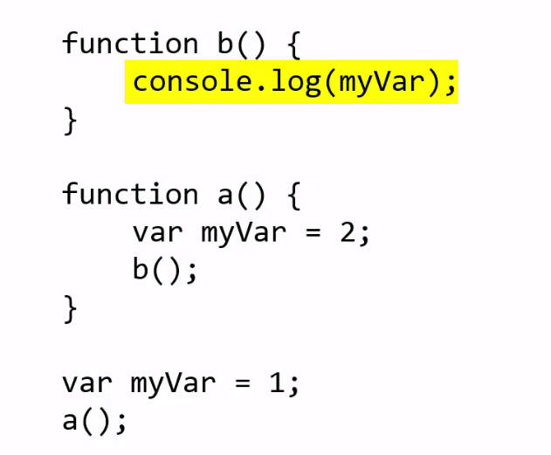
The Scope Chain

Slide 21
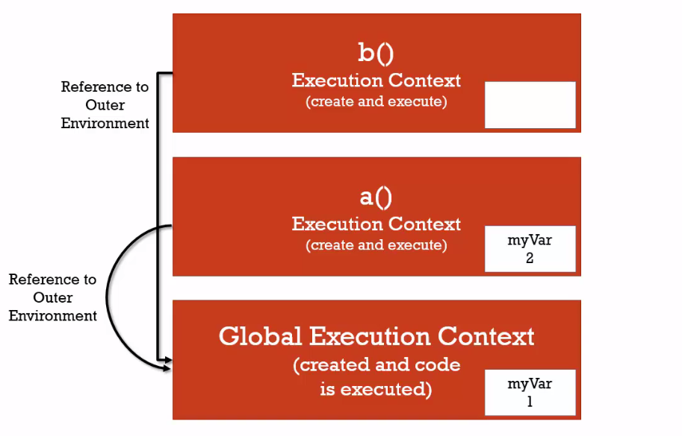

Slide 22
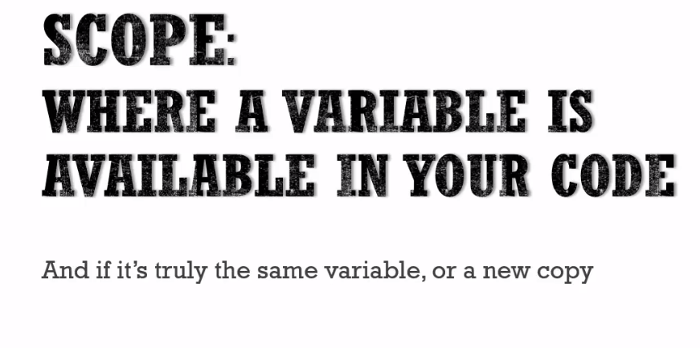
Scope, ES6 and let

Slide 23
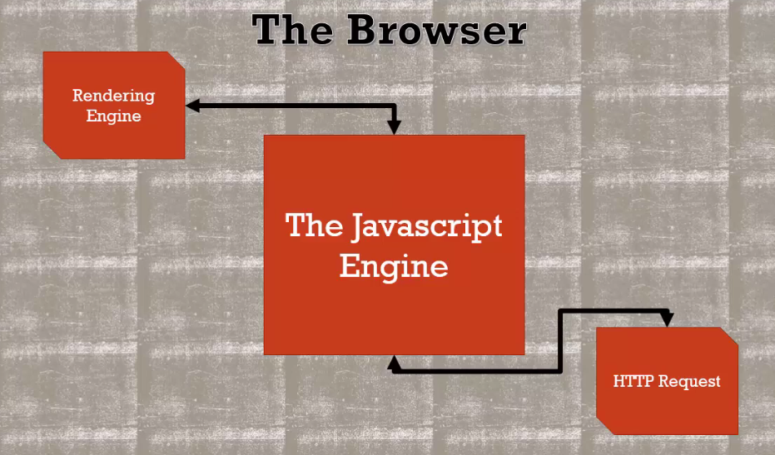
Asynchronous callbacks
More than one at a time ------------- how ?

Slide 24
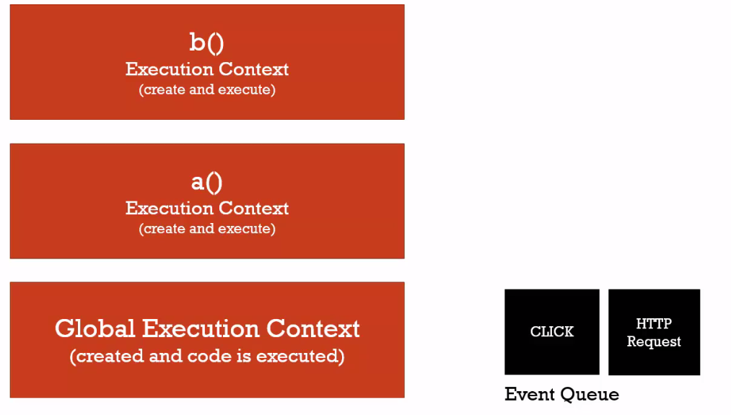
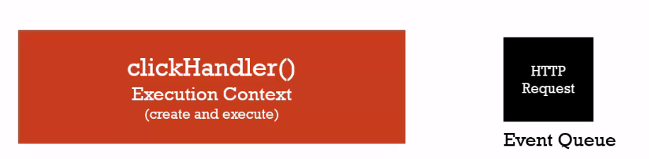

Slide 25
Types and Operators

Slide 26
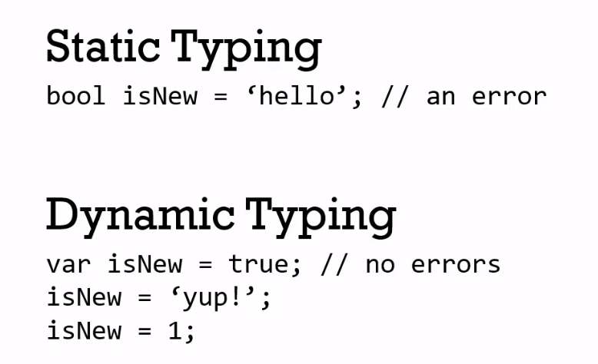
Different and special.. If you are from different background..
Dynamic typing – engines figures it out while its executing
Java, C++ === Static Typing , You tell before compilation .. You get error if assign different data type.
Javascript: No keyword to tell which data type

Slide 27
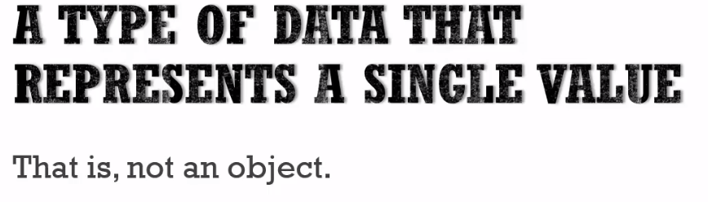
Primitive data type

Slide 28
undefined – Leave it for engine
null – Use it
boolen – true/ false
number – you can fake it for any type of numeric data (float)
string – Sequence of characters (single and double quotes , use any )
SYMBOL– ES6 – forget it now..

Slide 29
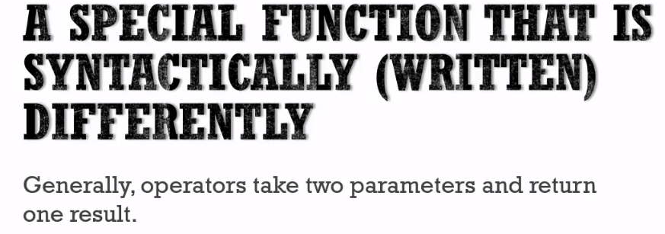
OPERATORS

Slide 30
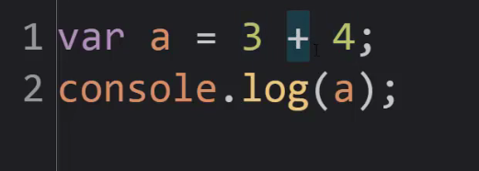

Slide 31
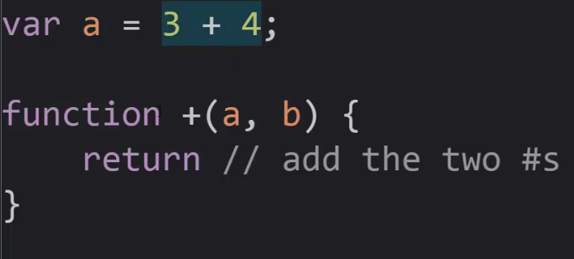

Slide 32
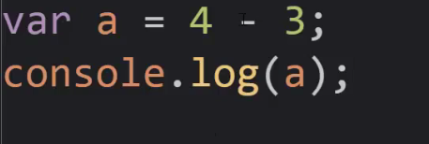
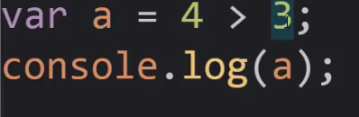

Slide 33
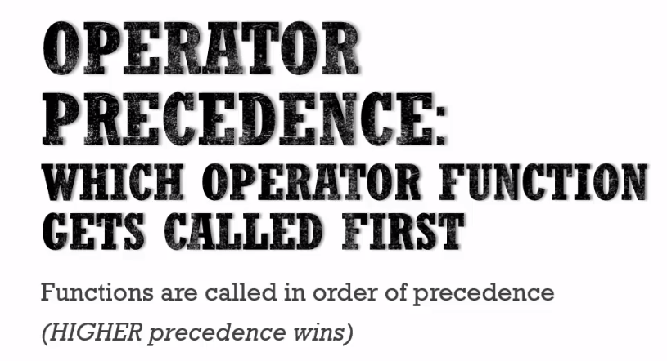

Slide 34
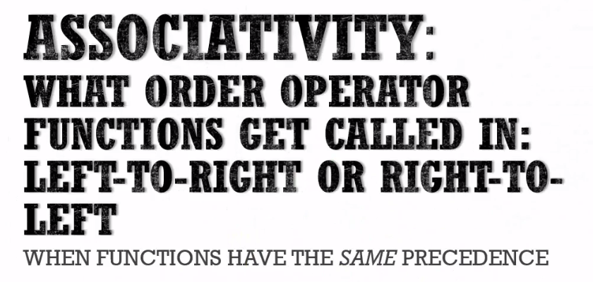

Slide 35
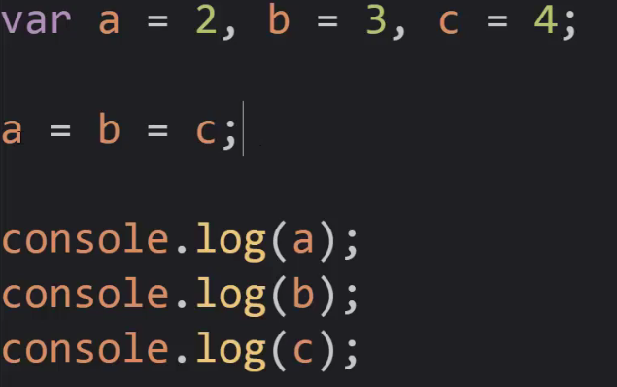

Slide 36
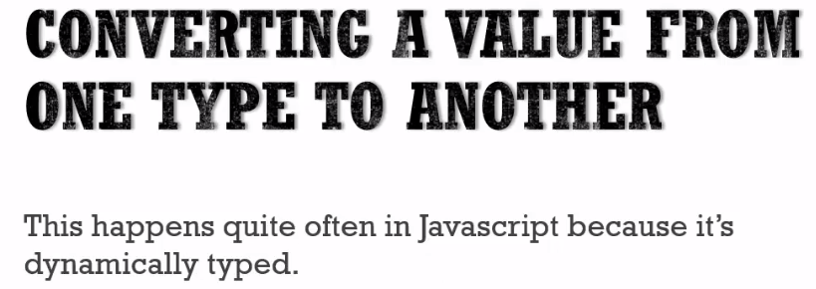
Coercion

Slide 37
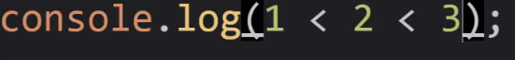
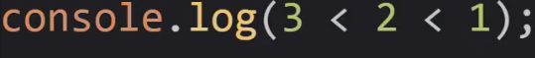
Comparison Operators

Slide 38
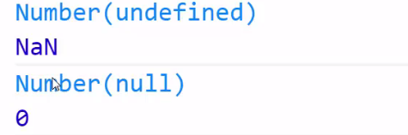
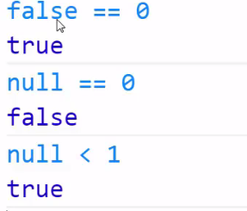
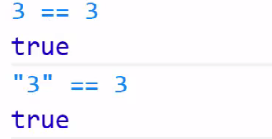
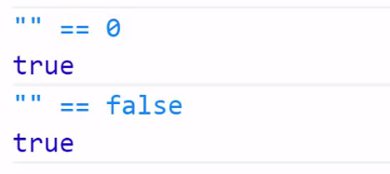

Slide 39
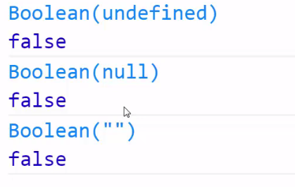
Existence and Booleans

Slide 40
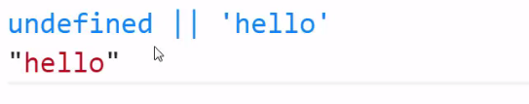
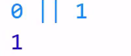
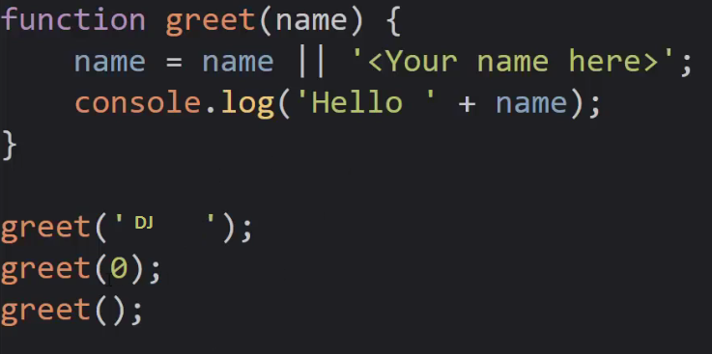
DEFAULT VALUES

Slide 41
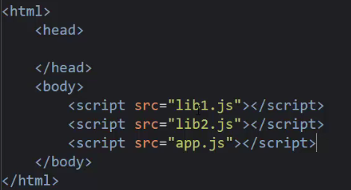
Default Values--- Multiple Files -- Frameworks

Slide 42
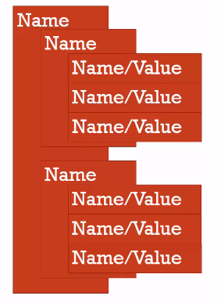
Objects and functions

Slide 43
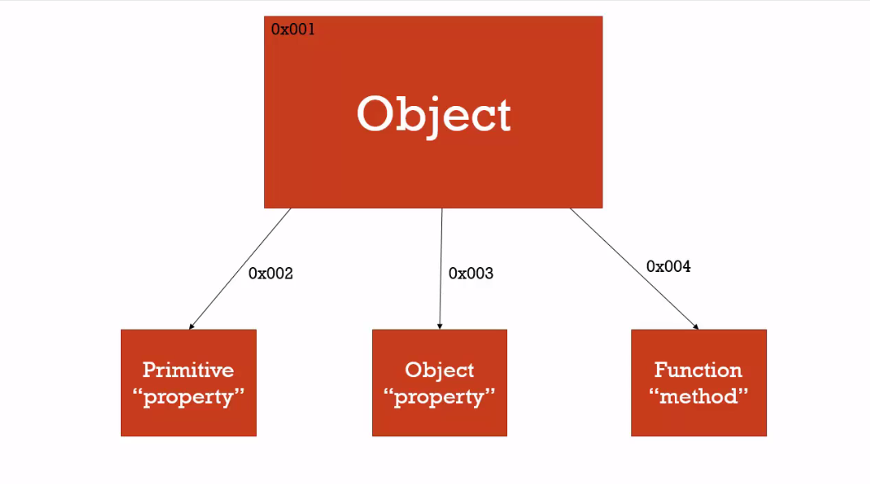
Objects and functions

Slide 44
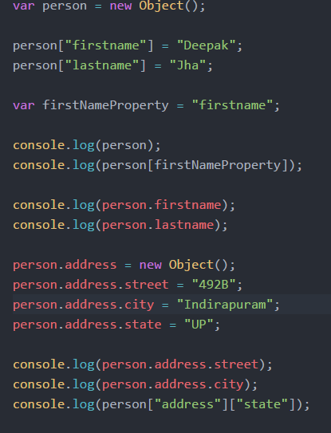
Ways of creating , accessing object (DOT, Computed property)

Slide 45
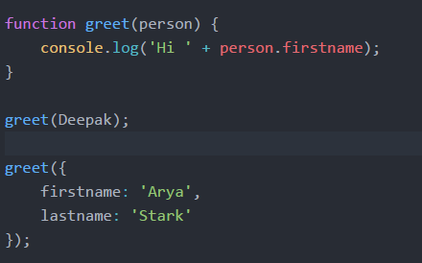
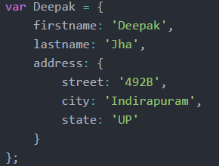
Objects and Object Literals

Slide 46
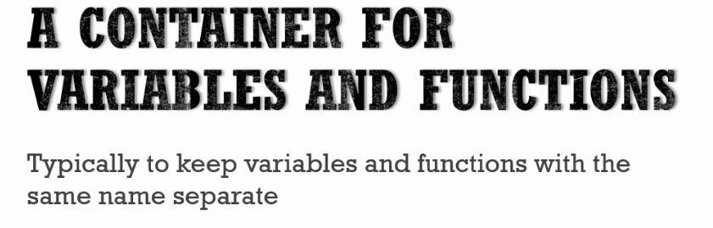
Namespace

Slide 47
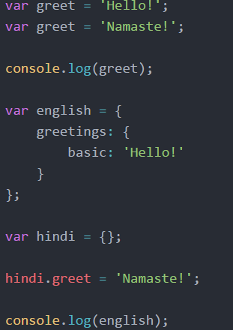

Slide 48
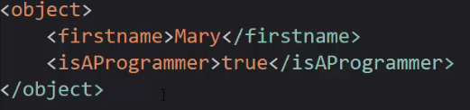


JSON and Object Literals
Javascript object notation

Slide 49


Slide 50

Functions are Objects
First Class Functions

Slide 51


Slide 52


Function Statements and Function Expressions

Slide 53


Slide 54


Slide 55

By Value vs By Reference

Slide 56


Slide 57


Slide 58
Objects and functions –Contd..
Objects, Functions and 'this'
Day 6 (JS)

Slide 59

Arrays - Collections of Anything

Slide 60

Arguments and spread

Slide 61


Slide 62
Function Overloading
Not Available , Fake it ☺

Slide 63

Syntax Parser
Automatic Semicolon Insertion
Whitespace
IIFEs and safe Code

Slide 64

IIFEs and safe Code

Slide 65


Slide 66


Slide 67
CLOSURES

Slide 68





Slide 69


Slide 70


Slide 71


Slide 72


Slide 73


Slide 74

Free variables

Slide 75

Closures are useful ?
Welcome to functional programming.
Function Factories

Slide 76


Slide 77

Closures and Callbacks

Slide 78

Call , Apply and Bind

Slide 79


Slide 80
Function borrowing and Currying

Slide 81


Slide 82
Functional Programming
Don’t let all the new words scare you away. It’s a lot easier than it sounds.

Slide 83



Slide 84







Slide 85


Slide 86


Slide 87


Slide 88

Reflection and Extend

Slide 89



Building Objects

Slide 90


Slide 91



Slide 92


Slide 93


Slide 94



Slide 95

In computer science, syntactic sugar is syntax within a programming language that is designed to make
things easier to read or to express. It makes the language "sweeter" for human use:
things can be expressed more clearly, more concisely, or in an alternative style that some may prefer.

Slide 96
'typeof', 'instanceof', and Figuring Out What Something Is

Slide 97


Slide 98


Slide 99


Slide 100


Slide 101
Thank You

